Slide 1
Parish and Town Council elections
Thursday 4 May 2023
Briefing for candidates
14 March 2023

Slide 2


Introductions
The Returning Officer is the person responsible for running the election
The Returning Officer is Will Godfrey
The Electoral Registration Officer is responsible for maintaining the register of electors and the absent voters’ lists
The Electoral Registration Officer is Will Godfrey
Electoral Services Team
Aurora Loi Electoral Services Manager elections@bathnes.gov.uk
Sarah Nicholds Senior Electoral Services Officer 01225 477431
Nick Jones Electoral Services Clerk

Slide 3
Election areas on Thursday 4 May
Parish and Town Council elections
45 parish councils
3 town councils
444 vacancies
Parish and Town Council elections are combined with
Bath & North East Somerset Council election
33 wards
59 vacancies

Slide 4
Topics
Key dates
Stand as a candidate
Nomination forms
Campaign
Voter ID
Voter Authority Certificate
Elections Act 2022

Slide 5
Event | Date
Briefing for candidates #1 | 6pm – Tuesday 14 March
Notice of election | Monday 20 March
Delivery of poll cards #1¹ | Monday 20 March
Nomination period starts | 9am – Tuesday 21 March
Nomination period closes | 4pm – Tuesday 4 April
Statement of persons nominated | 4pm – Wednesday 5 April
Notice of results for uncontested elections | 4pm – Wednesday 5 April
Briefing for candidates #2 (contested elections) | TBC
Despatch of postal votes #1² | Monday 17 April
Deadline for applications to register to vote | Monday 17 April
Deadline for new postal vote applications | 5pm – Tuesday 18 April
Deadline for changing existing postal/proxy arrangements | 5pm – Tuesday 18 April
Deadline for new proxy vote applications | 5pm – Tuesday 25 April
Deadline for Voter Authority Certificate applications | 5pm – Tuesday 25 April
Appointment of polling and counting agents | Wednesday 26 April
Polling day | Thursday 4 May
Verification B&NES and parish/town councils | 10:15pm – Thursday 4 May
Count B&NES | 10:15pm – Thursday 4 May
Count parish/town councils | 2pm – Friday 5 May
Delivery of return as to candidates’ election expenses | Thursday 1 June
Key dates
¹ Subsequent deliveries of poll cards on Tuesday 4 April, Wednesday 19 April and Wednesday 26 April
² Subsequent despatch of postal votes on Monday 24 April

Slide 6
Qualifications to stand as a candidate
Candidates must satisfy the following criteria on the day they are nominated and on polling day:
be at least 18 years of age
be a British citizen or qualifying Commonwealth citizen or EU citizen
Candidates must also satisfy at least one of the following criteria:
be a registered local government elector for the parish in which you wish to stand
have occupied as owner or tenant any land or premises in that parish during the whole of the 12 months preceding nomination and the day of election
their main or only place of work (including unpaid) during the last 12 months has been in that parish
have lived in that parish during the whole of the last 12 months

Slide 7
Disqualifications
A person cannot be a candidate if they:
are employed by the parish council
are subject of a bankruptcy restrictions order (or interim order)
have been sentenced to certain terms of imprisonment
are serving a disqualification due to being found guilty of a corrupt or illegal practice by an election court
Full list of disqualifications on Electoral Commission website
It is a matter for the candidate to determine their own eligibility to stand, and if necessary take advice from the Electoral Commission or their own personal legal advice.
The Returning Officer will not be able to confirm whether or not a candidate is qualified or disqualified.

Slide 8
The nomination forms
The nomination forms can be downloaded from the Electoral Commission website.
Printed copies can be also provided by the Returning Officer.
The deadline to submit all nomination forms is 4pm on Tuesday 4 April.
Please submit packs in their entirety, whether you think the pages are relevant or not.
The full pack includes:
form 1a Nomination paper
form 1b Home address form (both part 1 and part 2)
form 1c Candidate’s consent to nomination (pp. 1-5)
Party candidates will also need to submit:
a certificate authorising the use of the party name or registered description on the ballot paper
a written request to use one of the party’s emblems on the ballot paper (optional)

Slide 9
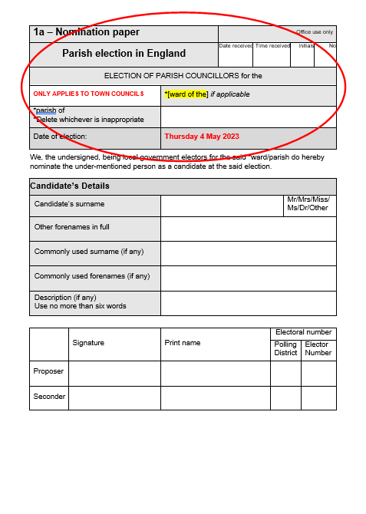
1a Nomination paper
The name of the ward only applies to Keynsham, Midsomer Norton and Radstock town councils
For all the other parish councils the ward field should be left blank.
Insert the name of the parish
Insert the date of the election (if not pre-populated)

Slide 10
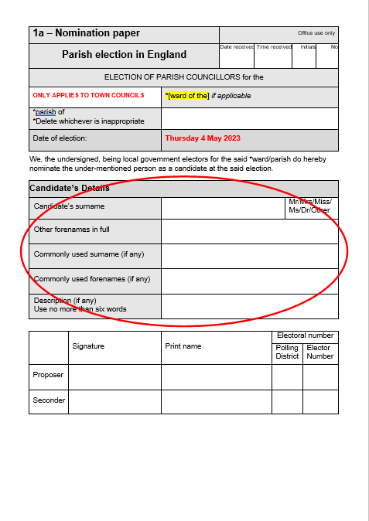
1a Nomination paper (continued)
Candidate’s full names must be added
A candidate can request to use a commonly used forename, surname or both
A candidate cannot use their first name as a commonly used name in order to exclude the use of their middle name
Description field (4 options):
1. leave blank
2. the word ‘Independent’
3. any description of no more than six words in English
4. party name or registered description if authorised by certificate issued by or on behalf of party’s nominating officer
The description will appear on the ballot paper and on notices

Slide 11
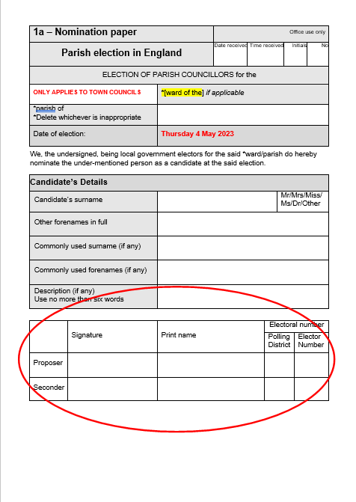
1a Nomination paper (continued)
Proposer and seconder
Must sign and print their names AFTER all candidate’s details have been completed
Must be registered electors in the parish (or town council ward) where the candidate is standing
Please ensure that proposer and seconder are aware of what their details will be used for
Electoral numbers must be included
Contact us if you don’t know the electoral numbers (elections@bathnes.gov.uk)

Slide 12
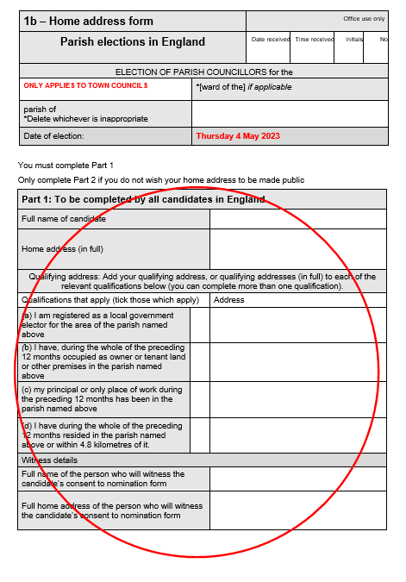
1b Home address form (Part 1)
Part 1 of the home address form
candidate’s full name (not any commonly used name)
candidate’s home address in full including the postcode (no abbreviations)
tick next to which qualification(s) apply
candidate’s qualifying address (to be completed even if it is the same as the home address above) or addresses, where candidate has declared on the consent to nomination that they meet more than one qualification
full name of the witness to the candidate’s consent to nomination
full home address of witness

Slide 13
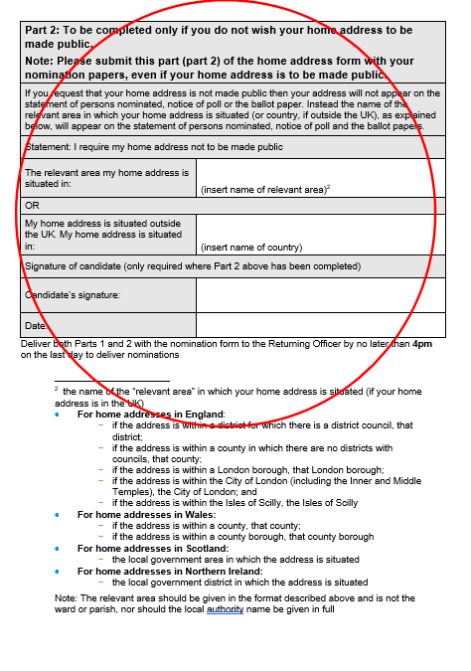
1b Home address form (Part 2)
Part 2 of the home address form
must be completed ONLY if the candidate does not want their address to be made public
if the candidate’s home address is in the UK, the name of the relevant area – for most candidates this will be ‘Bath and North East Somerset’
signed and dated by the candidate
Part 2 of the home address form must be submitted regardless of whether it has been completed or not.

Slide 14
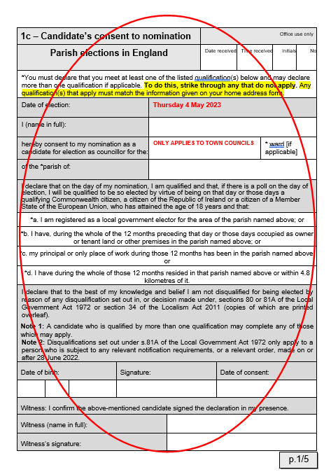
1c Candidate’s consent to nomination
The form must include:
date of election
details of parish (or town council ward)
candidate’s full name
confirmation of qualification(s) that apply (at least one, but include all that apply); must match qualifications on Home address form
candidate’s date of birth
candidate’s signature
date of consent (not earlier than 4 March)
name of witness in full
signature of witness

Slide 15
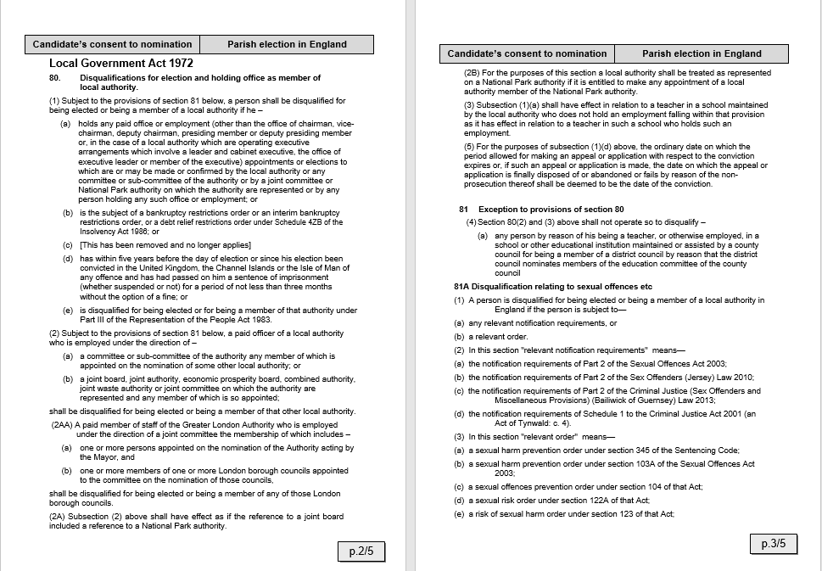
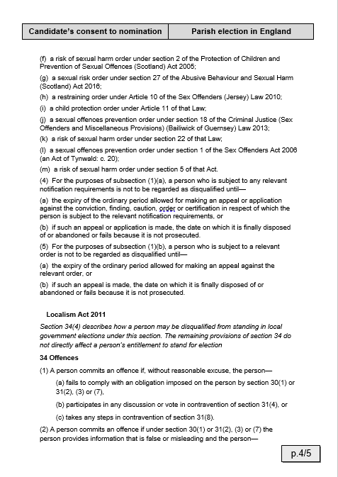
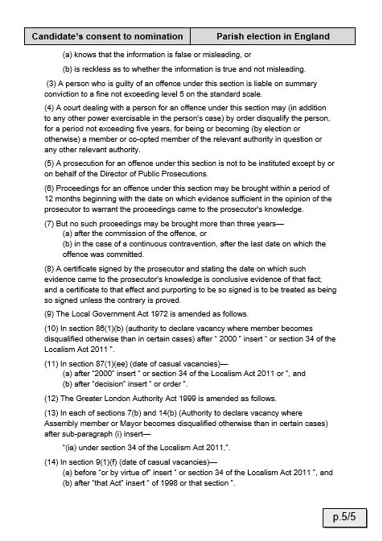
1c Candidate’s consent to nomination (continued)
Pages 2 to 5 are part of the candidate’s consent to nomination and must be included

Slide 16
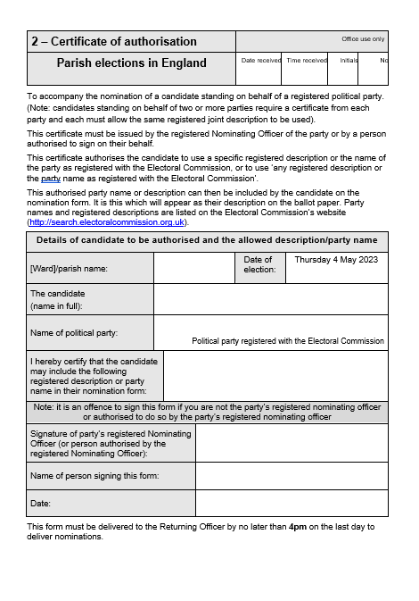
Certificate of authorisation form
Party candidates must have written permission to use the party name / registered description from the Party Nominating Officer (or a person authorised to act on their behalf).
If the certificate authorises the candidate to use the party name, the description field on the nomination paper must be the party name.
If the certificate authorises the candidate to use a particular registered description, the description field on the nomination paper must be that registered description.

Slide 17
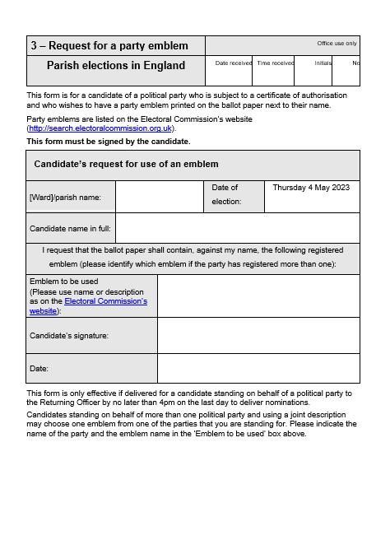
Request for a party emblem form
Party candidates can ask for an emblem to be printed on the ballot paper
Please use the description of the emblem and ID number as recorded on the Electoral Commission website
Candidate must complete, sign and date the form

Slide 18
Submitting nomination forms
We strongly advise that nomination papers are completed and submitted as early as possible during the nomination period.
Nomination period runs from 9am on Tuesday 21 March to 4pm on Tuesday 4 April.
Completed nomination forms must be delivered by hand to the Returning Officer staff at the Brunswick Room, Guildhall, High Street, Bath, BA1 5AW
No prior appointment for submission is required. However, be prepared for a wait time in the event of queues.
There are no restrictions on who can deliver the nomination forms nor on how many can be delivered at any one time.
If you are not delivering the form yourself, please attach a short note to your nomination pack with your email and contact telephone number.
Submissions will be processed strictly in receipt order, and if multiple, in bundle order.
We offer informal checks before the final submission.

Slide 19
Statement of persons nominated and notice of uncontested elections
Statement of persons nominated
published on 5 April
Notice of uncontested elections
published on 5 April
Briefing for candidates in contested areas
(date TBC)

Slide 20
Access to electoral register / absent voters’ lists
Access by candidates – once you officially become a candidate
Earliest on 27 March, if you or others declared yourself a candidate
Once you or others have declared yourself a candidate after this date / date you submit your nomination forms
Make written request to the Electoral Registration Officer
We can supply electoral numbers before 27 March to enable candidates to complete their nomination papers (elections@bathnes.gov.uk)
Only use data for permitted purposes:
to complete the nomination forms
to help you campaign
to check that donations / loans are permissible

Slide 21
Campaign dos and don’ts
Do use imprints on all your campaign material, including websites
Do comply with planning rules relating to advertising hoardings and large banners
Do make sure outdoor posters are removed 2 weeks after the election
Do not produce material that looks like a poll card
Do not pay people to display your adverts (unless they display adverts as part of their normal business)
Please read the Electoral Commission guidance for all the rules on the elections campaign.
Spending limit: £806 plus 7 pence per elector in the parish on register in force on 1 March.
All candidates are required by law to submit a spending return and declaration by 1 June 2023, whether the election is contested or not.

Slide 22
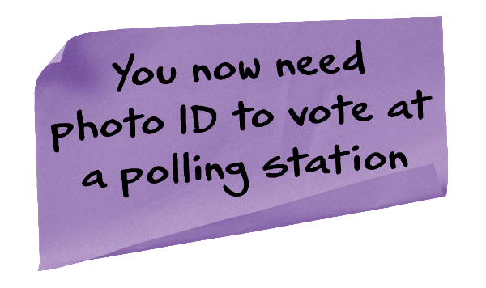
Photo ID at the polling station on 4 May 2023
 | Elections Act 2022 Voters must provide a form of accepted photo ID if they wish to vote in person at a polling station. If a voter fails to present photo ID they will not be issued with a ballot paper. This includes those who act as a proxy for another person. Photo ID provisions do not apply to postal voters.

Slide 23
Accepted forms of photo ID
Passport Photocard driving licence Blue badge Older person’s bus pass (including Diamond Travelcard) Disabled person’s bus pass Biometric immigration document National identity card issued by an EEA state Full list of accepted photo ID on GOV.UK Expired photo ID will be accepted, providing the photo is a good likeness. Voter Authority Certificate

Slide 24
Voter Authority Certificates
If the elector cannot provide one of the accepted forms of photo ID, they will be able to apply for a free Voter Authority Certificate from the Electoral Registration Officer.
The online application process opened on 16 January 2023.
Council Information and Advice Centres can assist electors in submitting an application.
The deadline to apply for a Voter Authority Certificate is 5pm on Tuesday 25 April 2023.

Slide 25
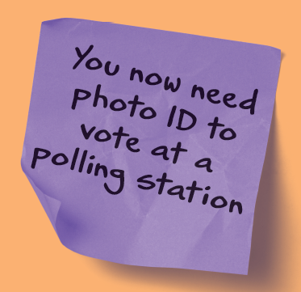
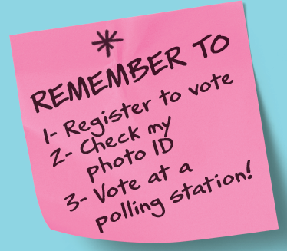
Public awareness campaign
Phase 1: Electoral Commission national awareness campaign (from 9 January)
Phase 2: Electoral Commission local awareness campaign (from 27 February)
Bath & North East Somerset Council local awareness campaign

Slide 26
Contacts
For any election queries please contact
Aurora Loi | Email | aurora_loi@bathnes.gov.uk elections@bathnes.gov.uk
 | Telephone | 01225 477431

Slide 27
Questions

